Slide 1
Secure U
PROACTIVISTS
Thrifty Kapila
Karun Pabbi

Slide 2
Algorithms / Datasets / Softwares we used
Mask R-CNN
Segmentic Analysis
OpenCV
Numpy
Python
COCO datasets
Spyder

Slide 3
Stage 1
Separating those video frames into multiple images [may decre]
Regions where there might be an object based on the input image.
Predicts the class of the object
Refines the bounding box and generates a mask in pixel level of the object based

Slide 4
Stage 2
Neural network takes proposed regions by the first stage
Several specific areas of a feature map level
Generates objects classes(multi-categorical classified), bounding boxes and masks

Slide 5
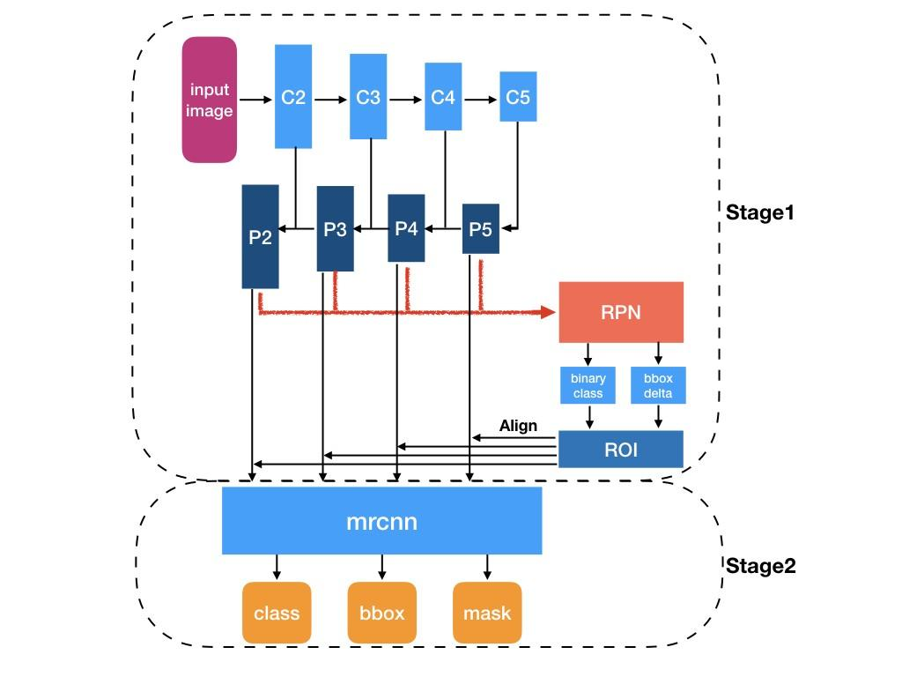

Slide 6
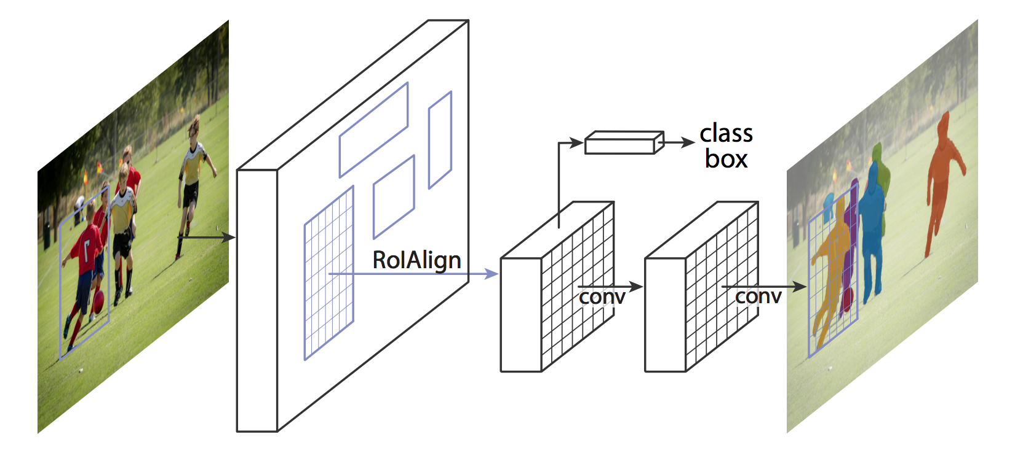

Slide 7
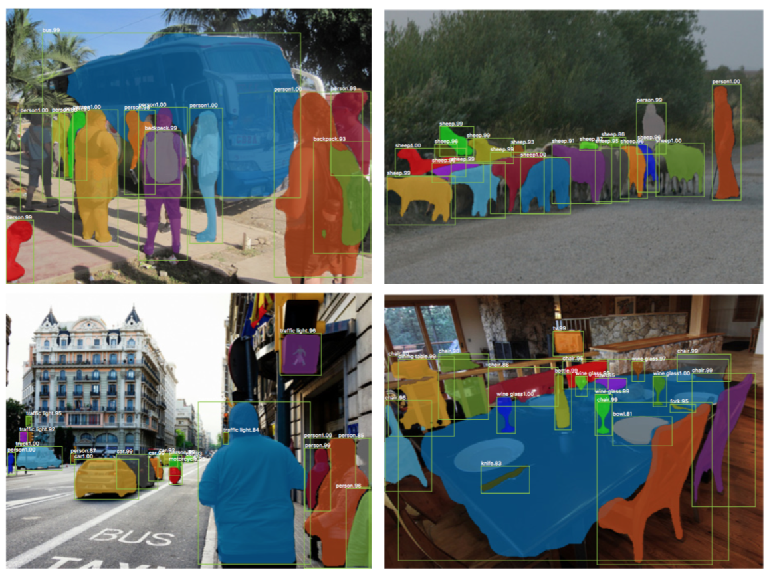

Slide 8
Why COCO
Object segmentation
Recognition in context
330K images (>200K labeled)
1.5 million object instances
80 object categories
91 stuff categories
5 captions per image
250,000 people with keypoints

Slide 9
Future Scope
With higher resolution of datasets and video recordings
Sentiment analysis and demographic evaluations
Faster Processing
Look for other alternative as Heroku don’t provide GUI

Slide 10
Thank You

